Slide 1
Shy Song 2018 / 01 / 25
🌏
The Insecure Http Protocol

Slide 2
HTTP
HyperText Transfer Protocol

Slide 3
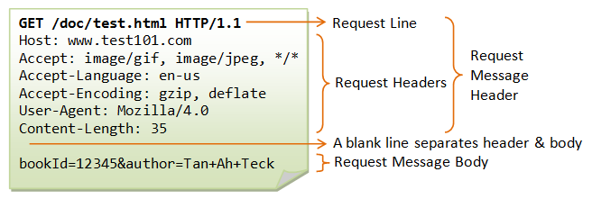
http 1.1

Slide 4
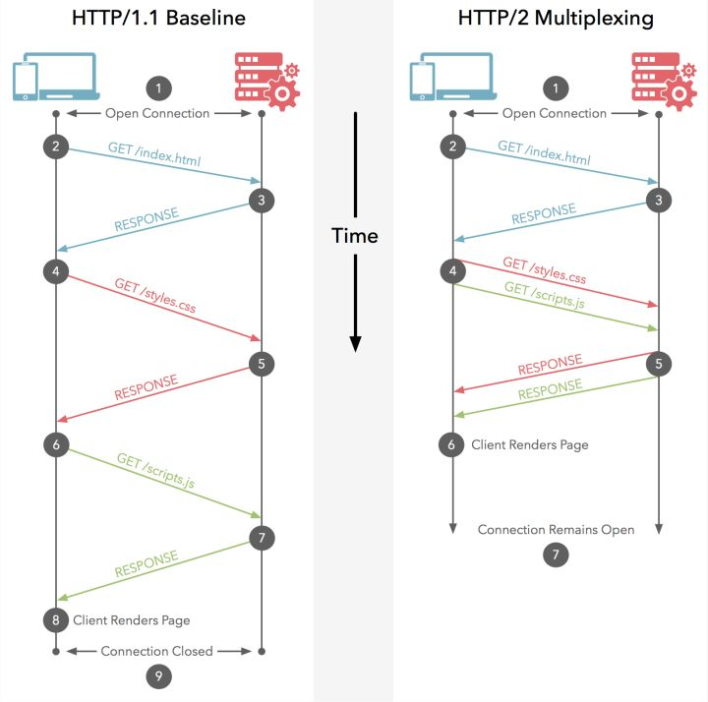
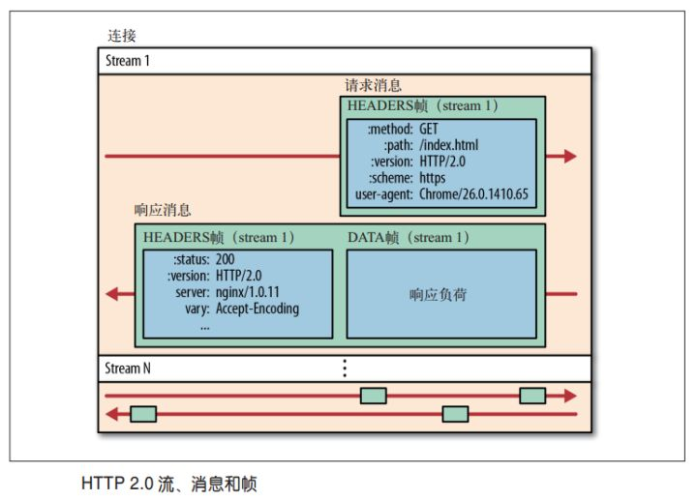
http 2.0
Notes:
高带宽，低延迟，TCP慢启动

Slide 5

man in the middle

Slide 6
WEB SoftWare
fiddler
HTTP/HTTPS Traffic Recordig
Web Debugging
Web Session Manipulation
Customizable Free Tool
burpsuit
Web vulnerability scanner
Advanced manual tools
Essential manual tools
Notes:
关键字过滤：公司跳板机2台以上切换
IP封锁：亚马逊某个ip段全部中招

Slide 7

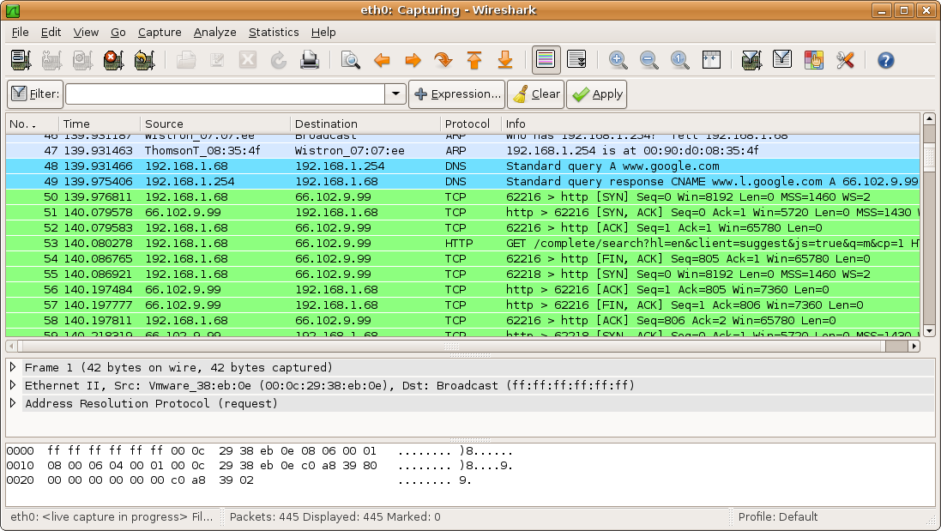
Notes:
关键字过滤：公司跳板机2台以上切换
IP封锁：亚马逊某个ip段全部中招

Slide 8
the type of MITM
hosts
wifi
gateway

Slide 9
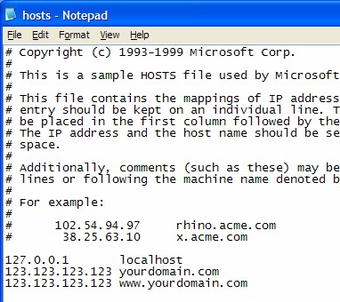
hosts
· cracked software
· proxy
· vpn
· SS
· shadows
· manual

Slide 10
wifi
Aircrack-ng
https://www.aircrack-ng.org/
a network software suite consisting of a detector, packet sniffer, WEP and WPA/WPA2-PSK cracker and analysis tool for 802.11 wireless LANs.

Slide 11
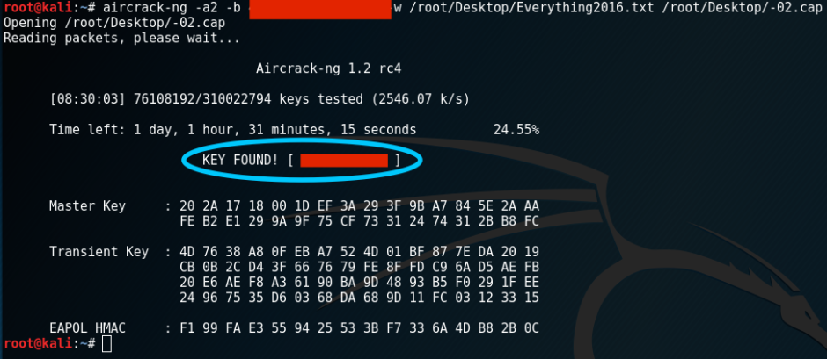
wifi

Slide 12
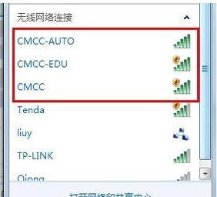
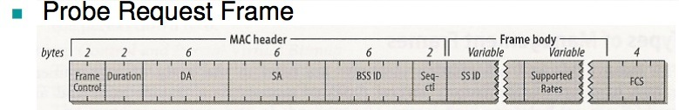
Service Set Identifier

Slide 13
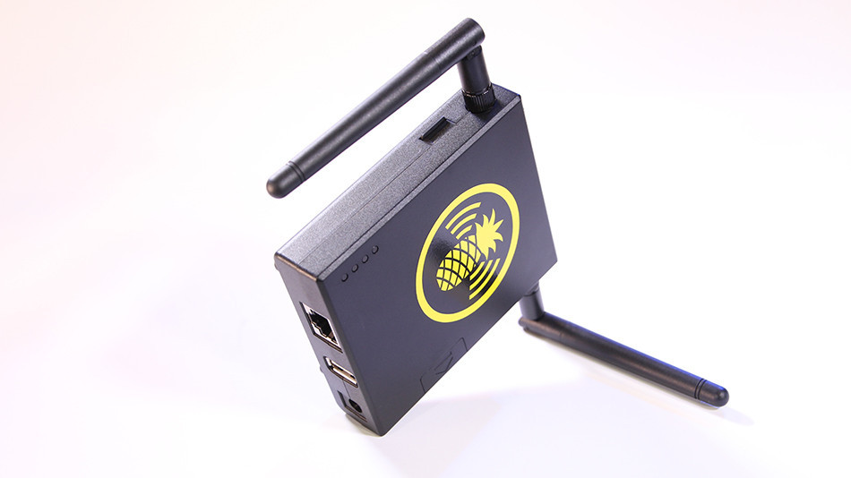
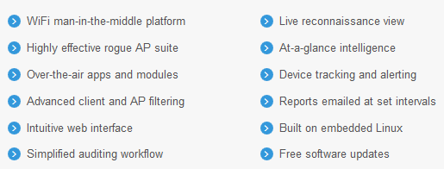
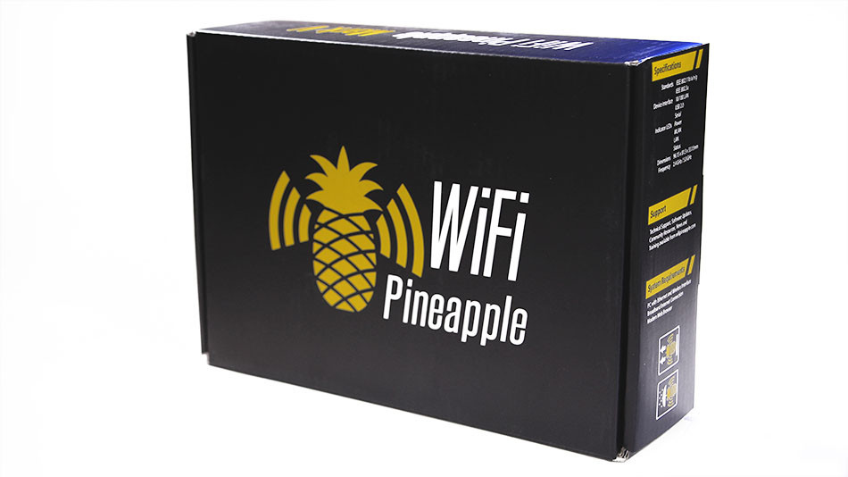
wifipineapple
$ 99.99
https://wifipineapple.com/

Slide 14
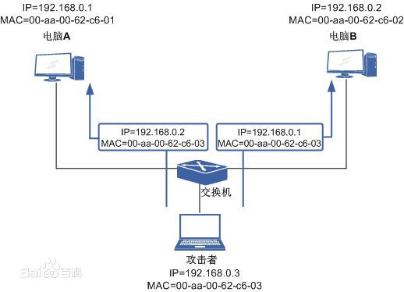
Address Resolution Protocol

Slide 15
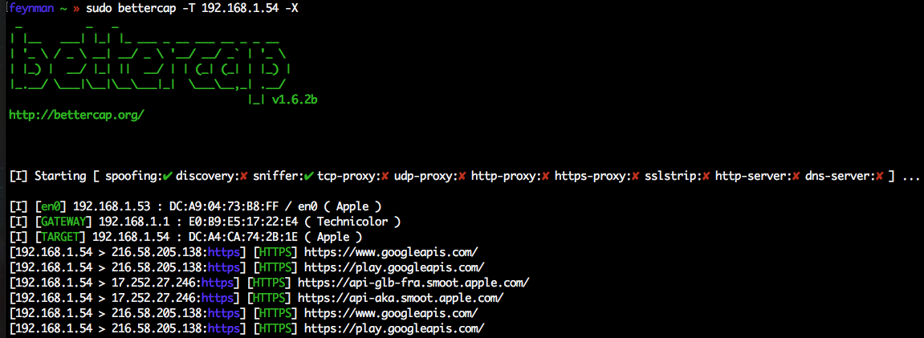
bettercap

Slide 16

phishing page attack

Slide 17
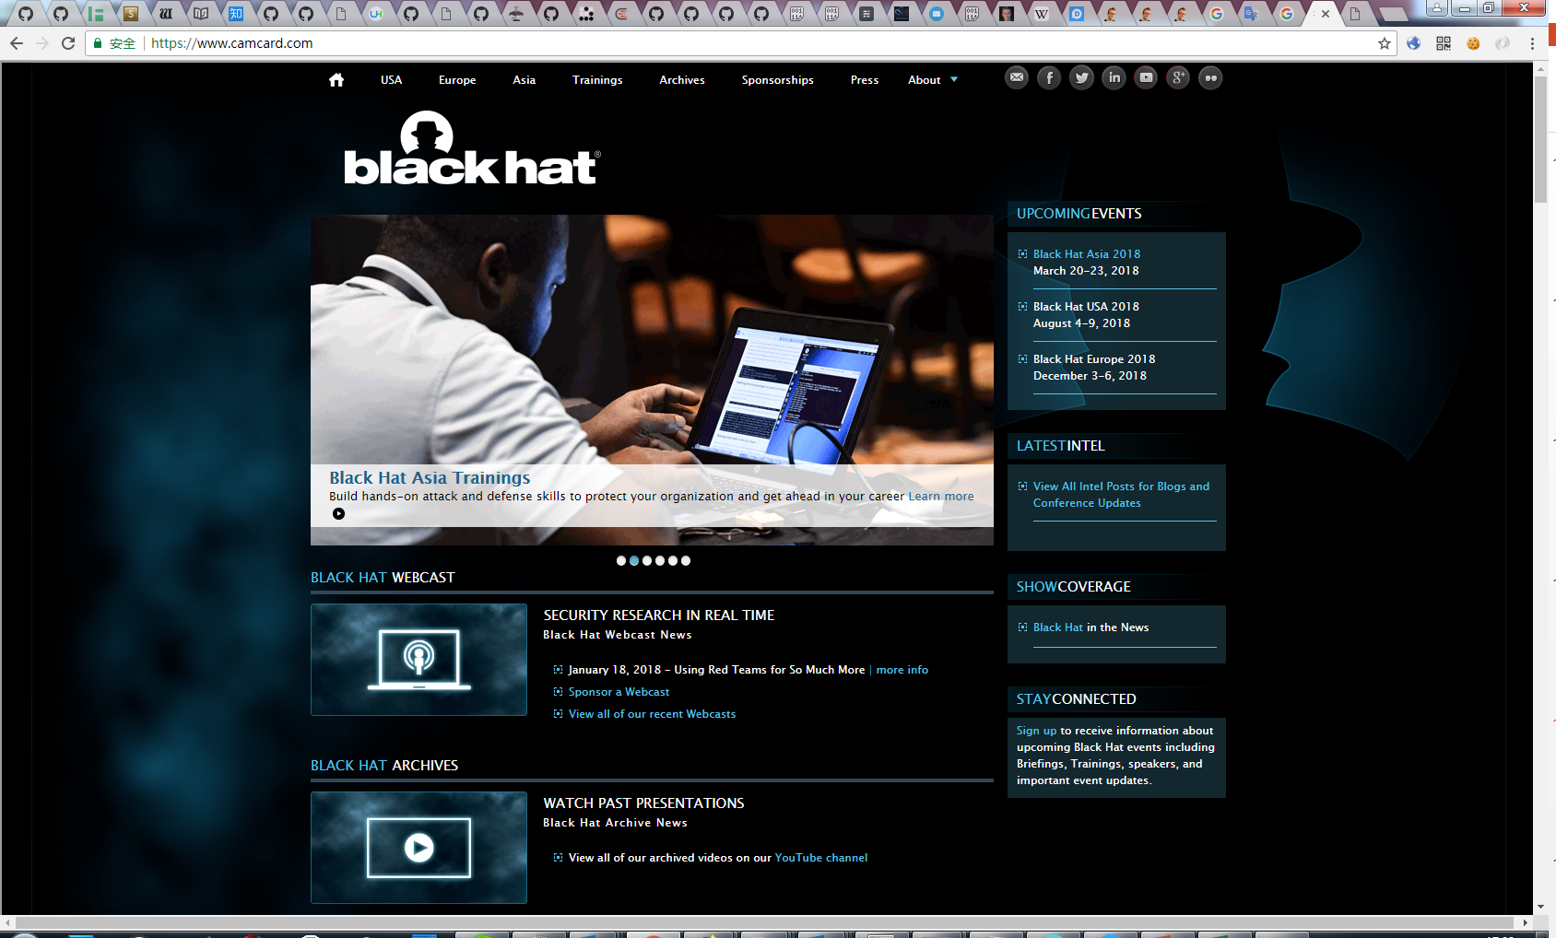
iframe

Slide 18

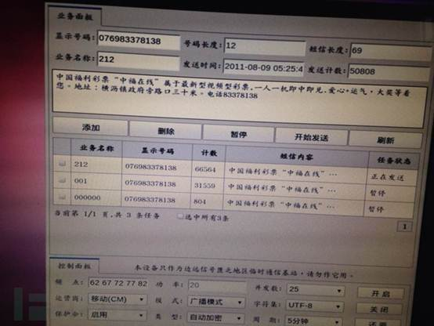
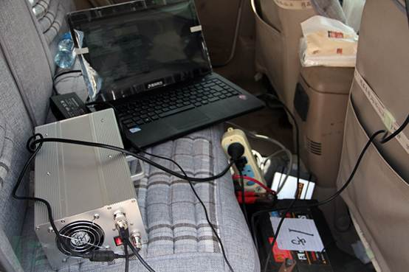
Pseudo base station

Slide 19
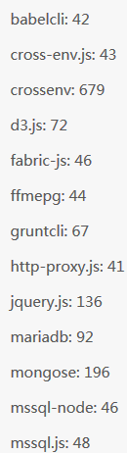
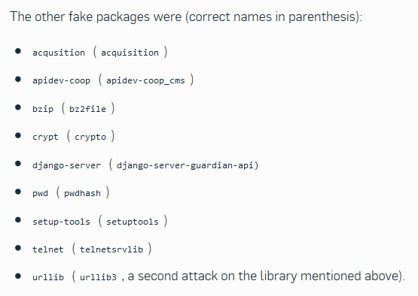
typosquatting
www.zdao.com
www.zda0.com
www.2dao.com
www.zdao.cn
www.zaodao.com

Slide 20

Http over Secure Socket Layer
· 12 packets for SSL, vs 3 for TCP alone
· TCP handshake took 114ms
· Total SSL handshake time was 436ms
· Number of network round-trips was 3.
· SSL portion took 322ms (network and crypto)

Slide 21
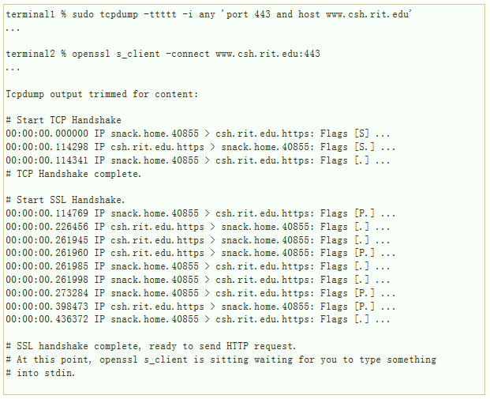

Slide 22
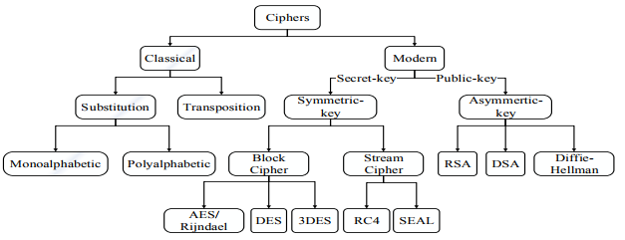
Classification of Encryption Methods

Slide 23
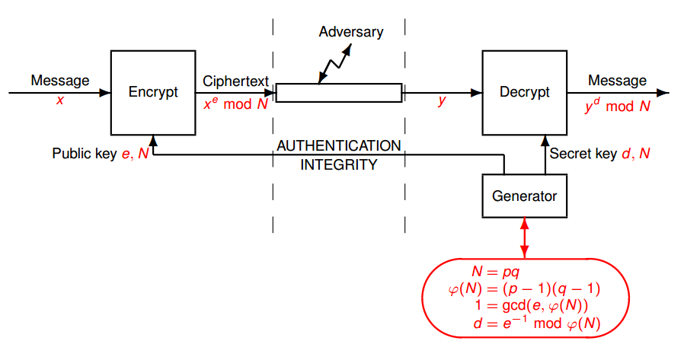
Rivest–Shamir–Adleman

Slide 24
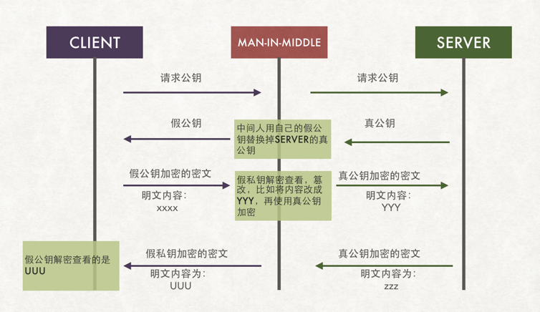

Slide 25
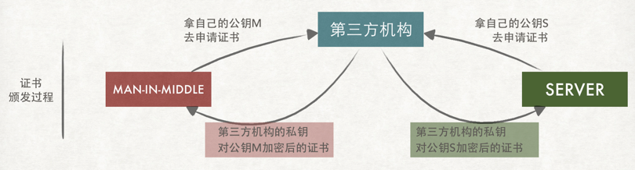
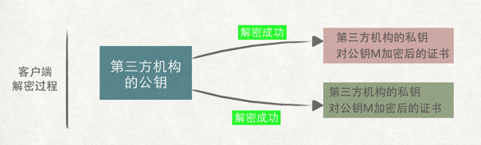

Slide 26
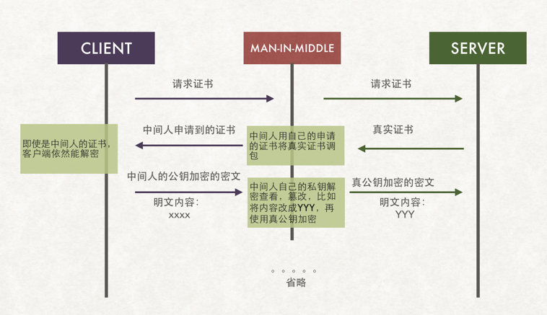

Slide 27

🏃
http
Google
🏃
https

Slide 28
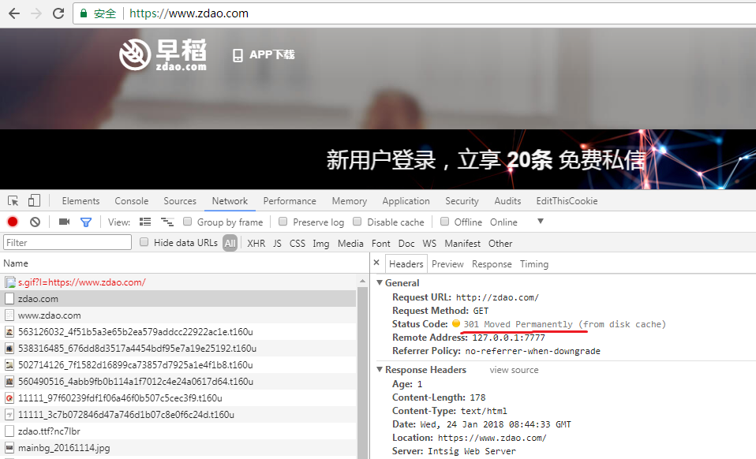
BAD : http to https

Slide 29
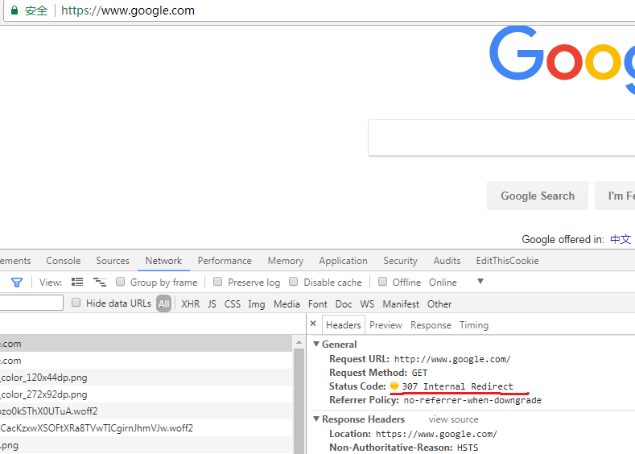
why is 307 ?

Slide 30
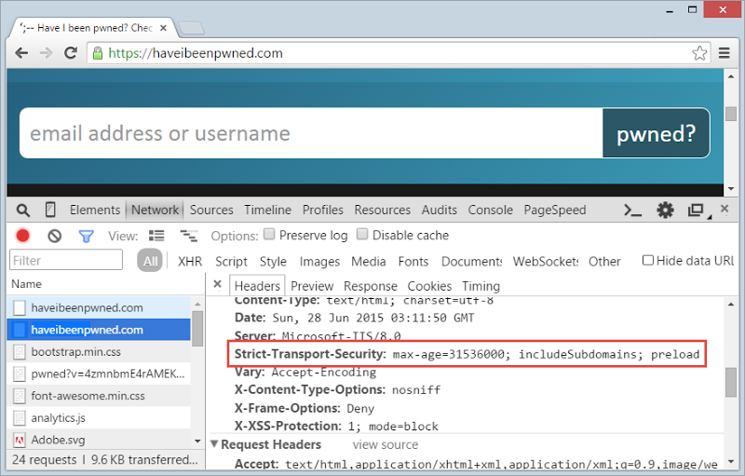
HTTP Strict Transport Security

Slide 31
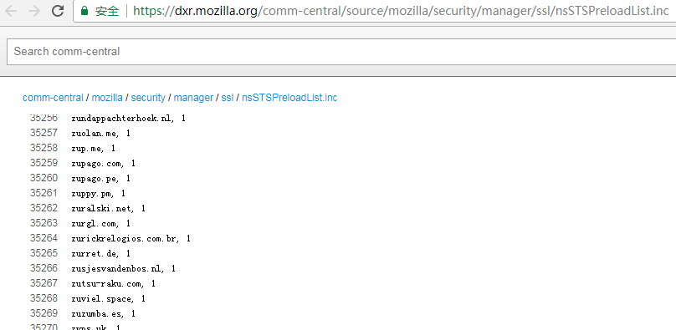
Chromium’s HSTS preload list and Mozilla’s
https://chromium.googlesource.com/chromium/src/+/master/net/http/transport_security_state_static.json
https://dxr.mozilla.org/comm-central/source/mozilla/security/manager/ssl/nsSTSPreloadList.inc

Slide 32
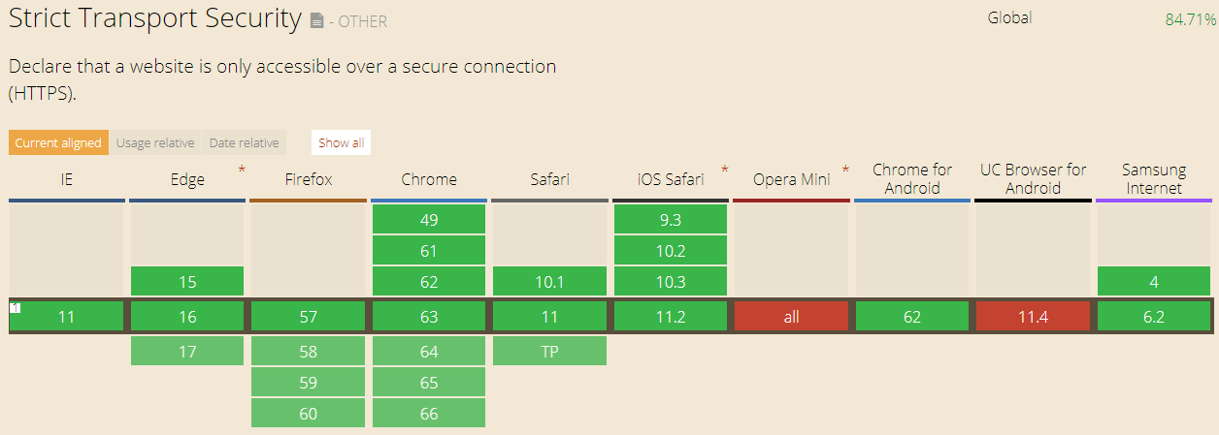
HSTS support

Slide 33
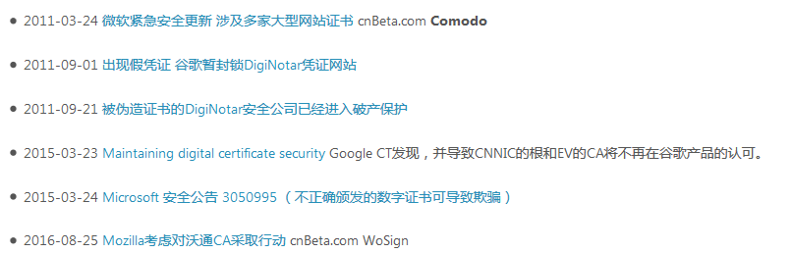
CA Public Key

Slide 34
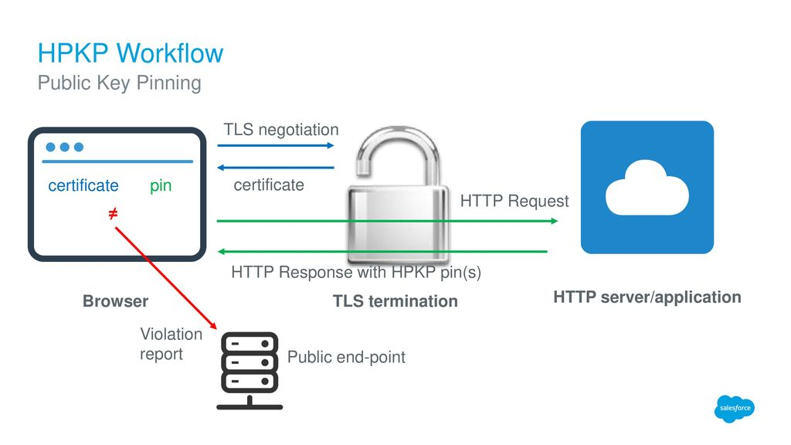
HPKP - HTTP Public Key Pinning
add_header Public-Key-Pins 'pin-sha256="YLh1dUR9y****BgFF2Fuihg="; max-age=2592000; includeSubDomains';

Slide 35
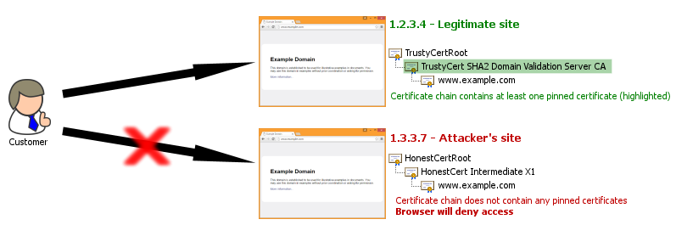
Google abandons public key pinning
· Google introduced HPKP support for Chrome around 3 years ago back in September 2015.
· On 30 Oct 2017 Google's Chris Palmer announced plans to deprecate HPKP support by Chrome from May next year .
· Chrome v67, 375 website

Slide 36
https://pdfs.semanticscholar.org/187d/26258dc57d794ce4badb094e64cf8d3f7d88.pdf
https://scotthelme.co.uk/bypassing-hsts-or-hpkp-in-chrome-is-a-badidea/
https://en.wikipedia.org/wiki/HTTP_Public_Key_Pinning
https://www.troyhunt.com/understanding-http-strict-transport/
https://www.cnblogs.com/zhangshitong/p/6478721.html
https://nakedsecurity.sophos.com/2017/09/19/pypi-python-repository-hit-by-typosquatting-sneak-attack/
http://www.freebuf.com/articles/web/126210.html
https://www.secpulse.com/archives/6068.html
http://www.moonsec.com/post-544.html
https://baike.baidu.com/item/DNS%E6%AC%BA%E9%AA%97/8759836?fr=aladdin
https://www.zhihu.com/question/34074946
https://www.w3.org/Protocols/rfc2616/rfc2616-sec4.html
http://www.kalitut.com/2014/06/what-is-kali-linux.html

Slide 37
thanks!
Any questions?

